Slide 1
ECSE 211
Design Principles and Methods
TEAM 2

Slide 2
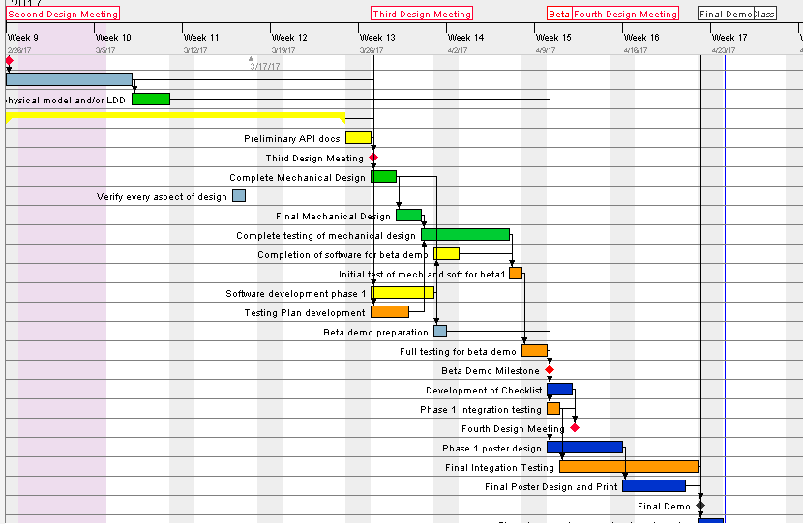

Slide 3
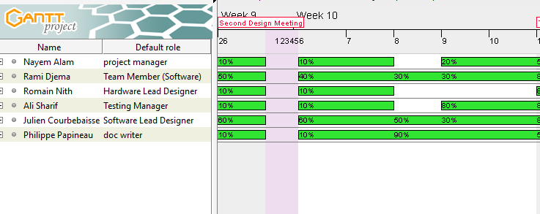

Slide 4
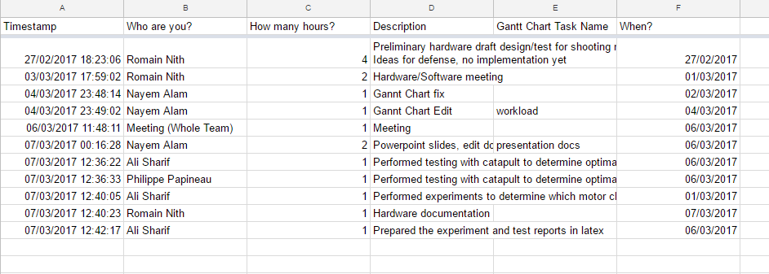
Budget
For Week 2

Slide 5
Mechanical Design

Slide 6
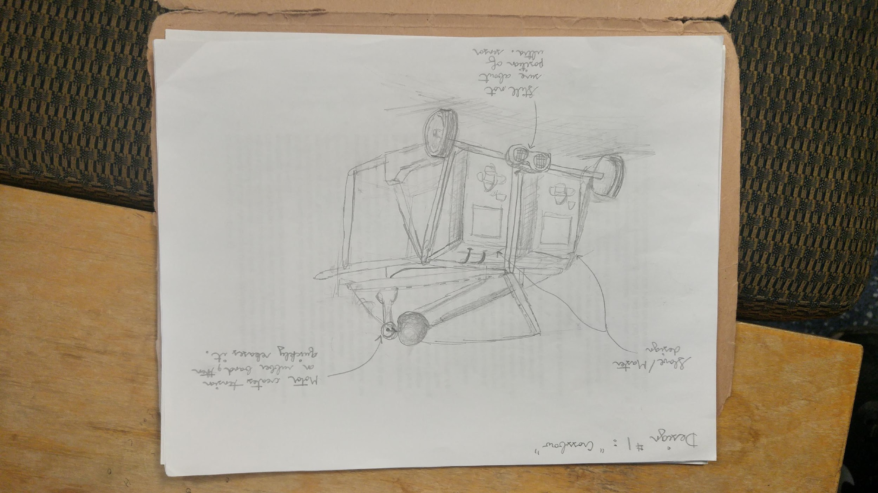

Slide 7
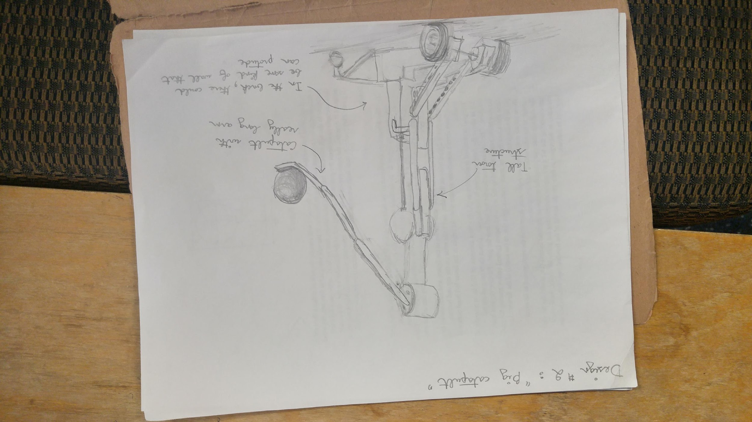

Slide 8
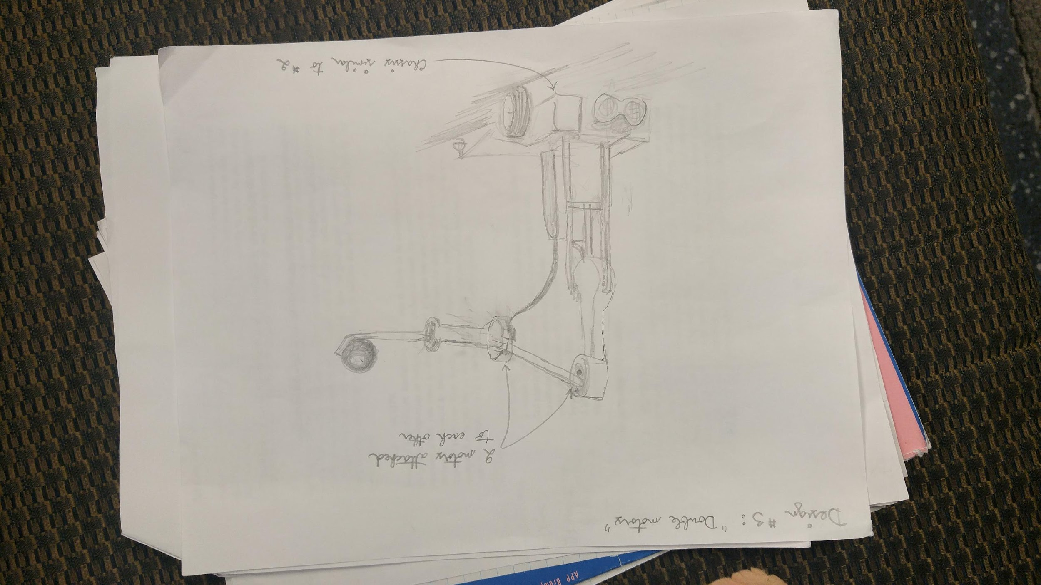

Slide 9
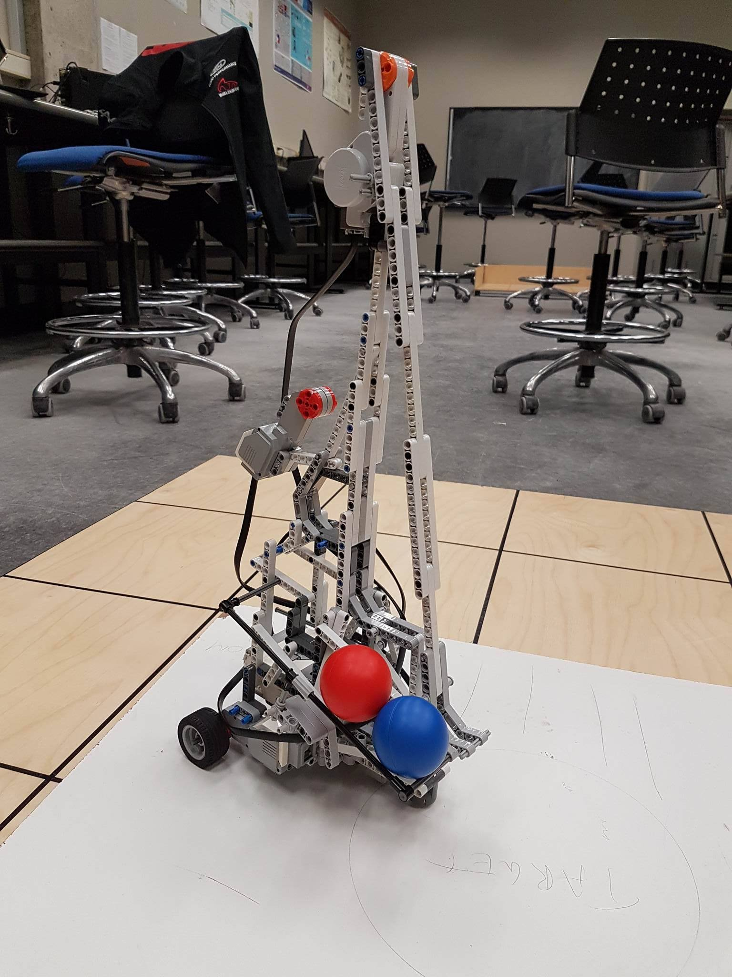
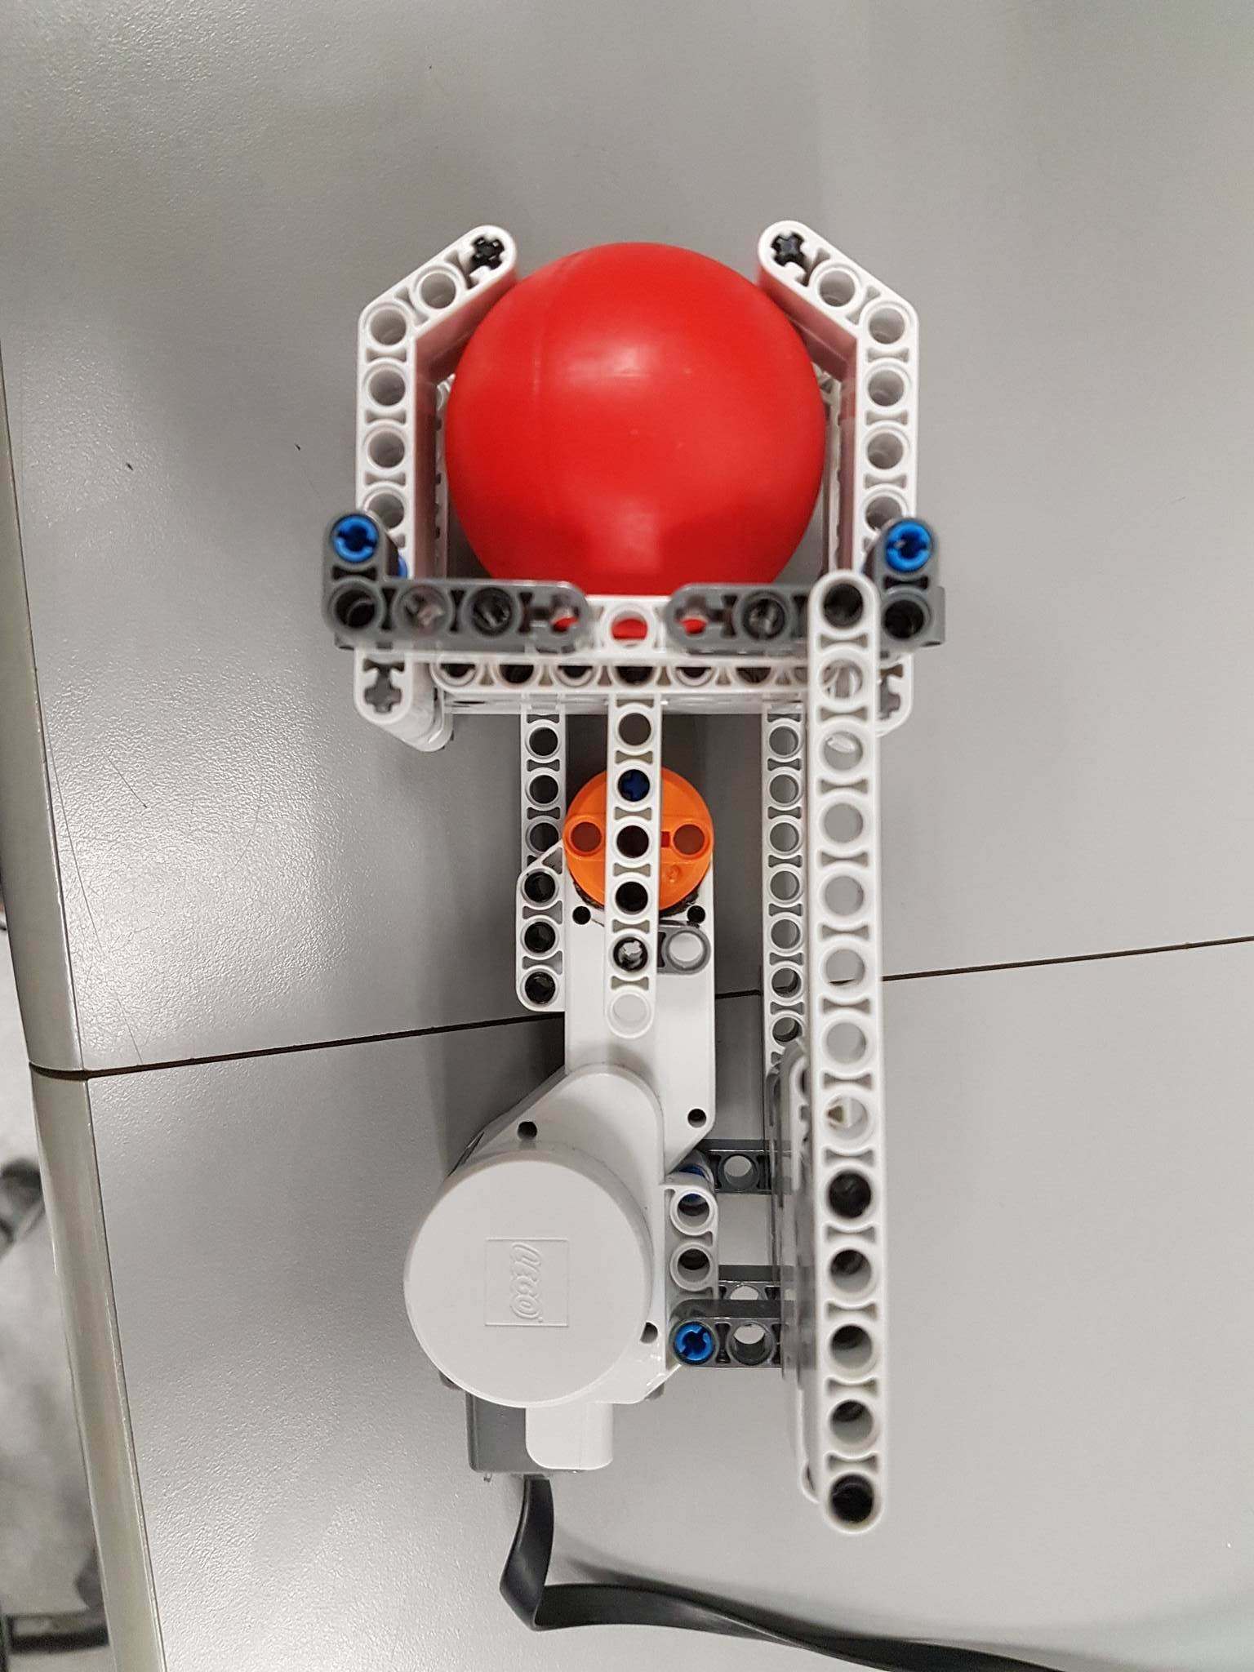

Slide 10
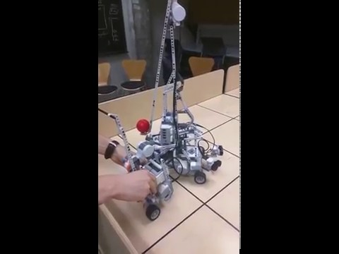
Mechanical Design Demo

Slide 11
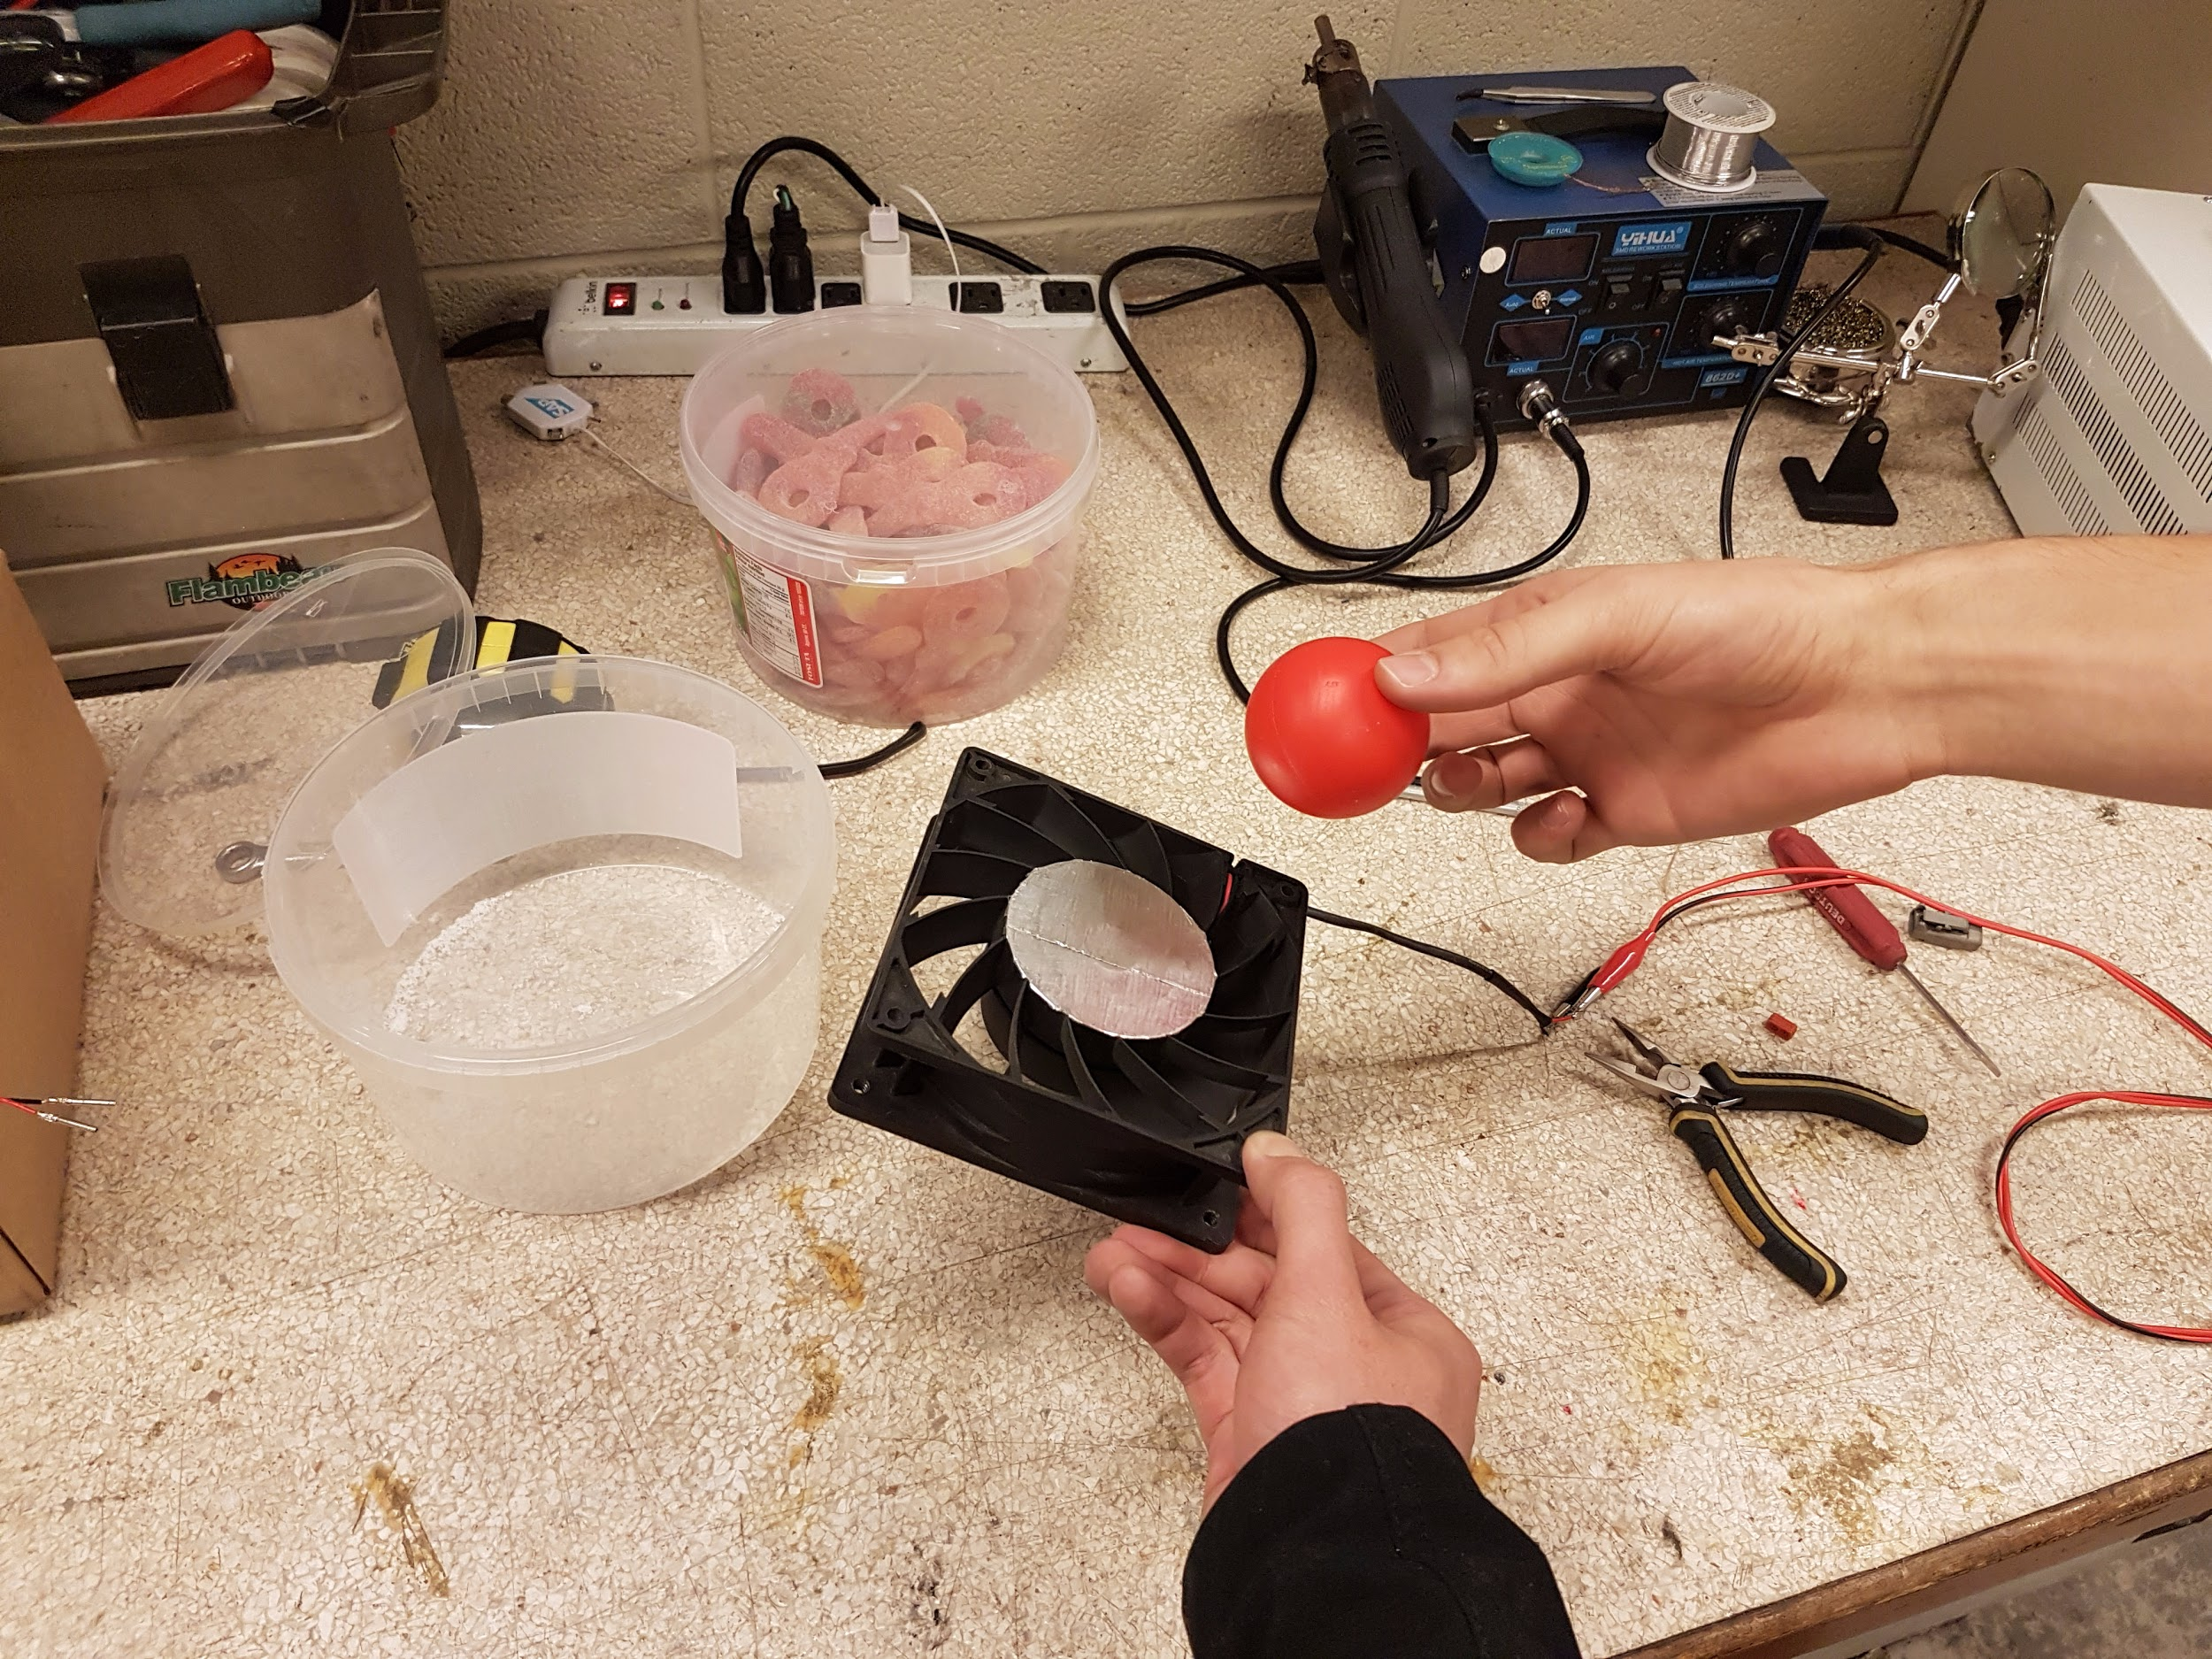
Defense Mechanism
Other ideas:
Sailing mat
Deploying wall

Slide 12
Software Architecture

Slide 13
Basic Modules and Interfacing
Pathfinder module - Generates optimal path for odometer correction according to grid structure
Pilot - Moves robot according to instructions from Pathfinder
Odometer Correction - Uses light sensor pulses, path information to correct odometer
Odometer - Generates position and heading data using wheel tachometers
Main/Entry Point - Logic thread containing instructions on how to act in the context of the competition
Ball Launcher - Controls the launcher’s motor
Localizer - Runs once at the start to orient and position robot

Slide 14
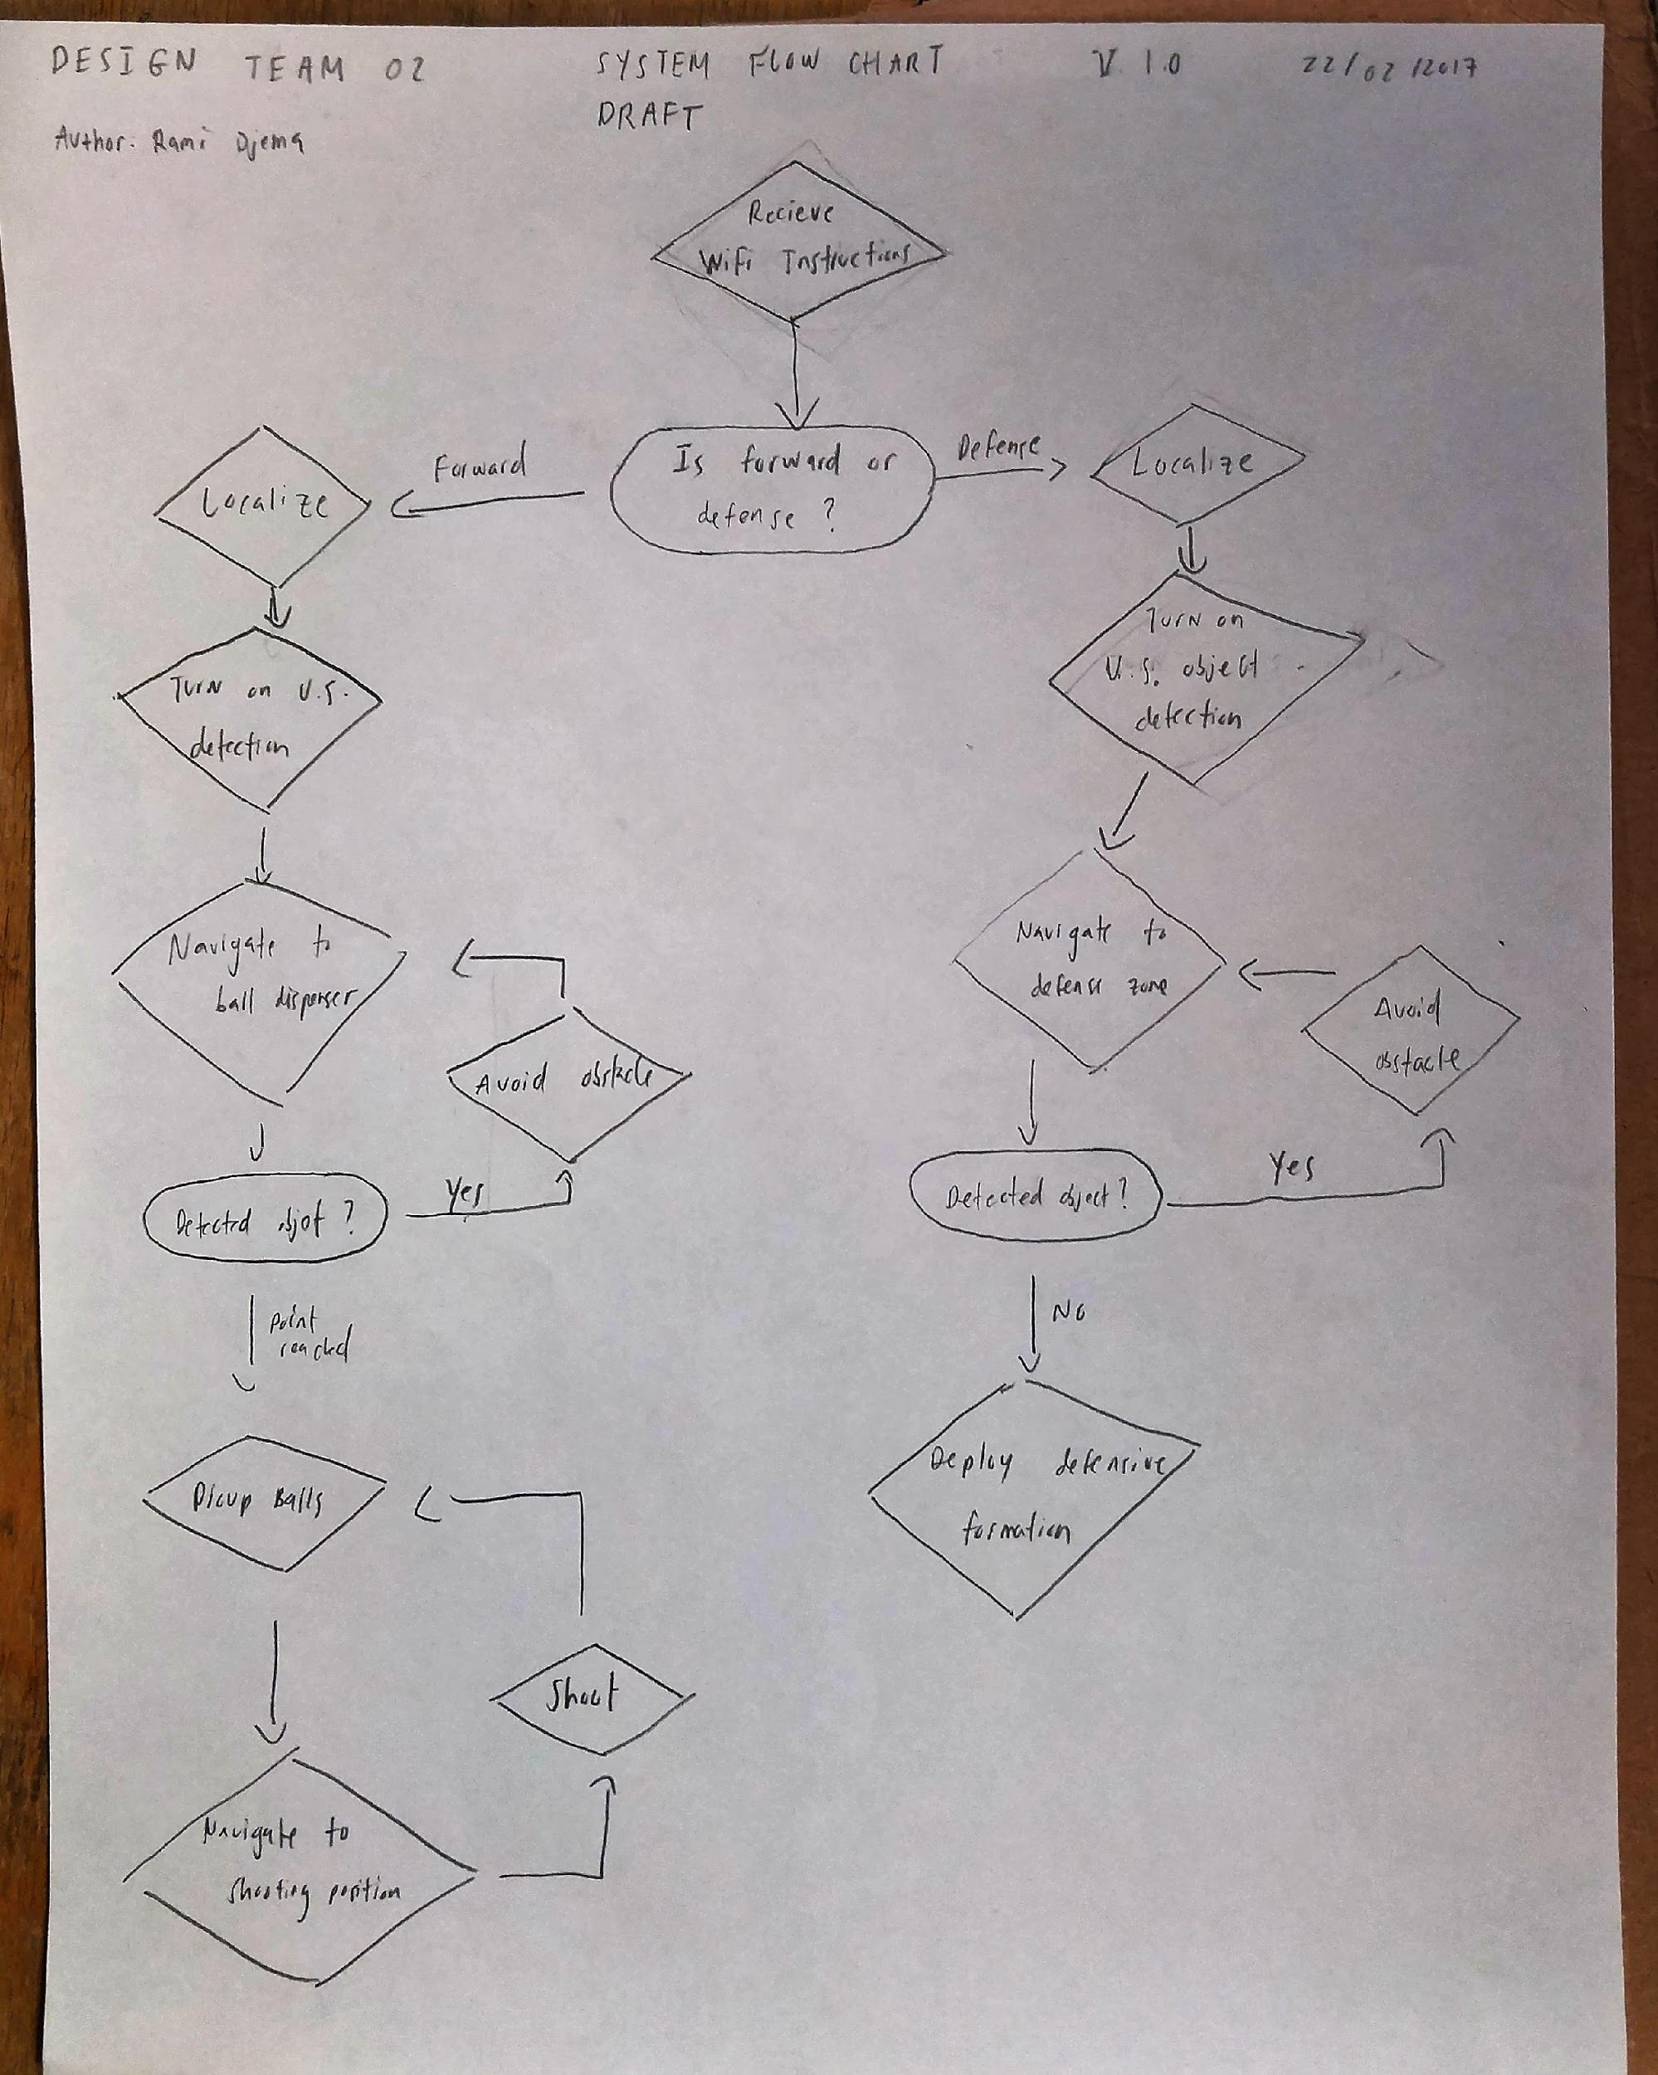

Slide 15
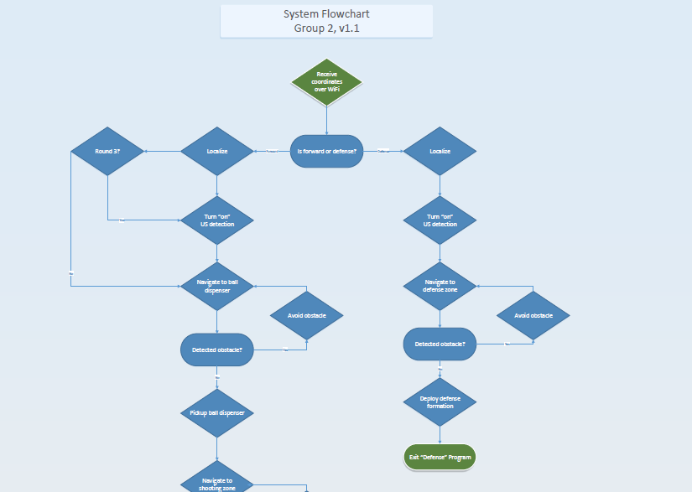

Slide 16
Final Project in relation to Lab 5
The final project allowed us to experiment with different launch mechanisms and develop and understanding of ballistics for this project

Slide 17
Plans for the following week
Finish building the piston design
Complete the Pathfinder, Odometer Correction, and Pilot code
Test the mechanical design completely

